Slide 1
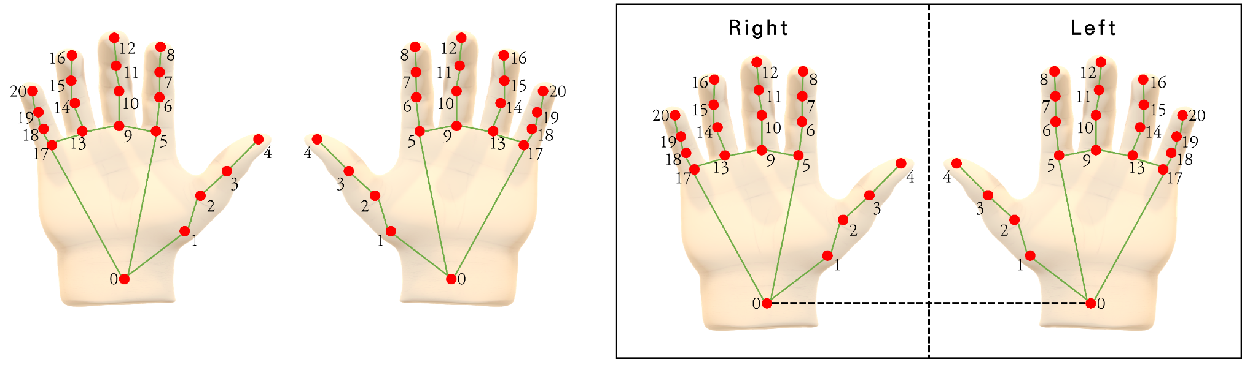
Right & Left Hand Detection
ECEN 360
LIZZETT TAPIA
ALFONSO WONG DUARTE
JACOB RIVERA

Slide 2
Overview
This project focuses on building a real-time Left and Right Hand Detection system using OpenCV, MediaPipe, and Machine Learning.
OpenCV is an open-source computer vision library that enables webcam access, frame capture, and real-time video processing.
MediaPipe is a powerful framework developed by Google that provides various libraries and tools for customizable ML models.

Slide 3


Project Approach
Train Machine Learning Classifier
Hand Data Collection
ML Model Integration

Slide 4
Hand Data Collection
Created a python script that uses MediaPipe, OpenCV, and CSV output in order to help save labeled hand landmark data from a webcam
The script detects one hand using the webcam and draws hand landmarks on the screen
The user is able to press ‘l’ to save data for the left hand, or ‘r’ for the right hand
The hand landmark data & label proceeds to get saved to a .csv file for future training

Slide 5
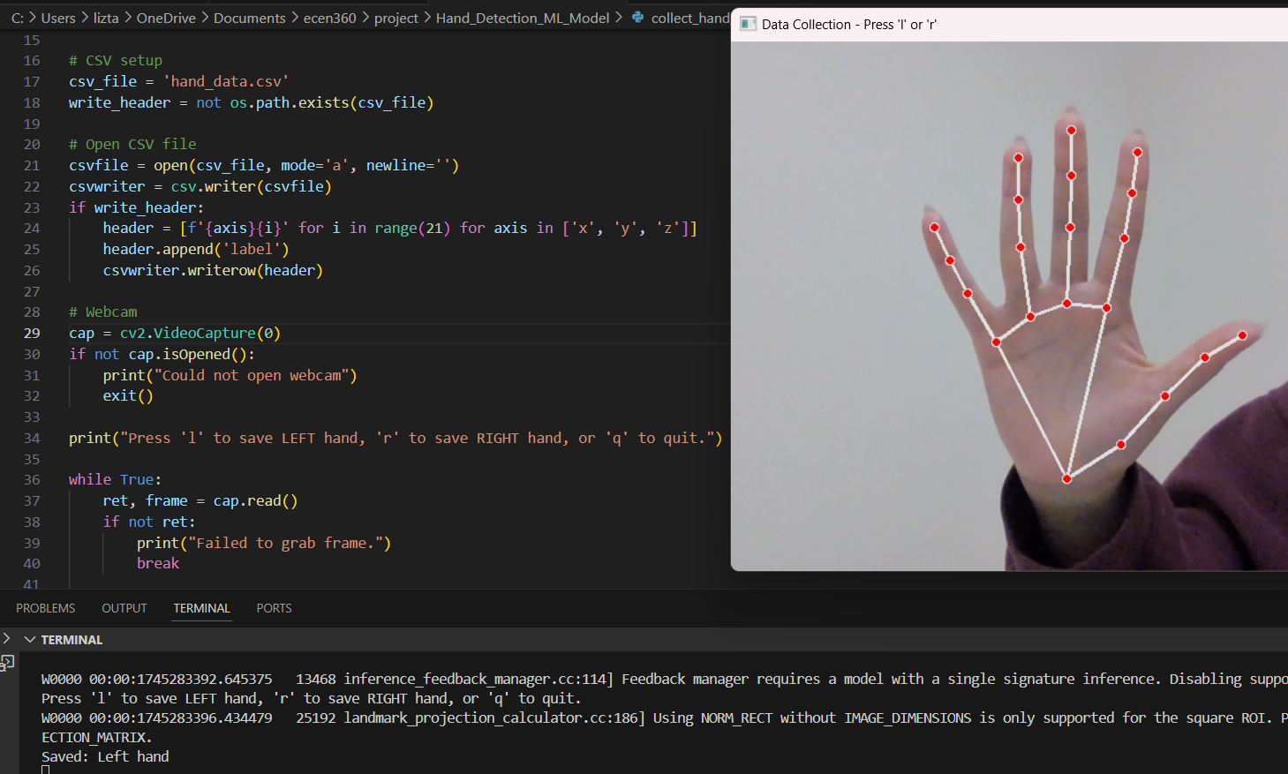
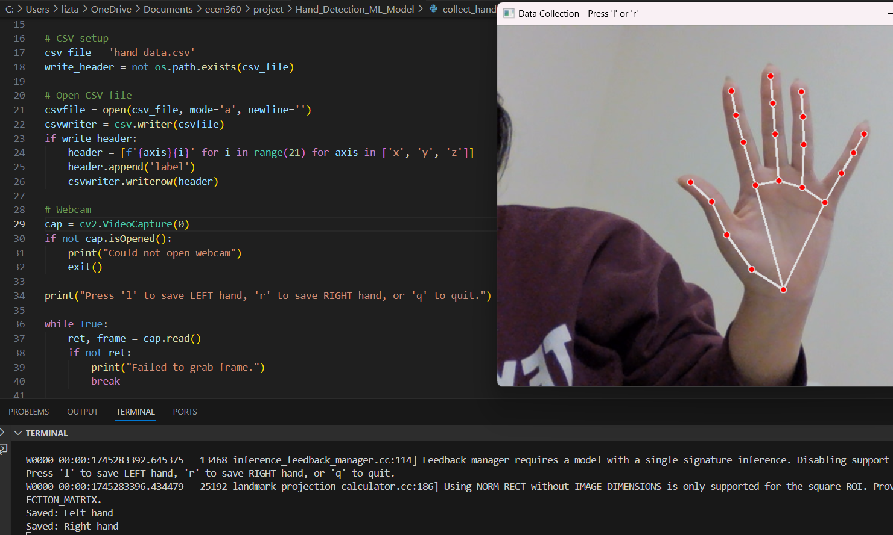

Slide 6
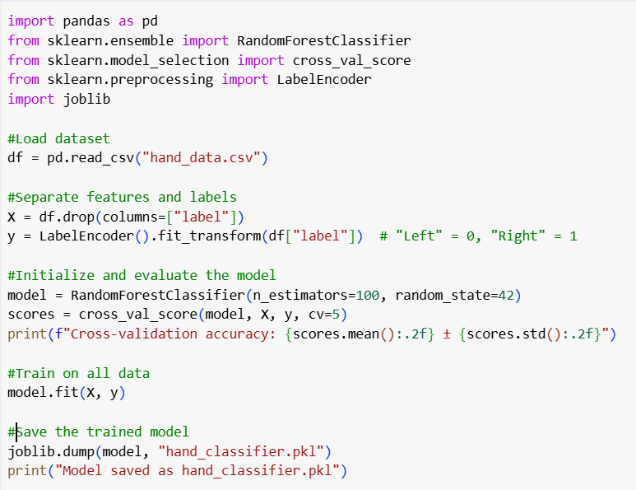

Training Machine Learning Classifier
The second script created takes the hand landmark dataset that was previously collected.
It uses the dataset to help train a machine learning classifier (Random Forest), evaluates how accurate it is, and saves the trained model for future real-time use.
Random Forest Classifier is a machine learning algorithm that builds multiple decision trees and makes predictions based on the majority vote from those trees, improving accuracy and reducing the risk of overfitting. MediaPipe already provides built-in handedness classification, but Random Forest model is trained specifically in our hand data. This personalizes the prediction to our hand shape and orientation, as well as allowing full control over how the classification works.

Slide 7
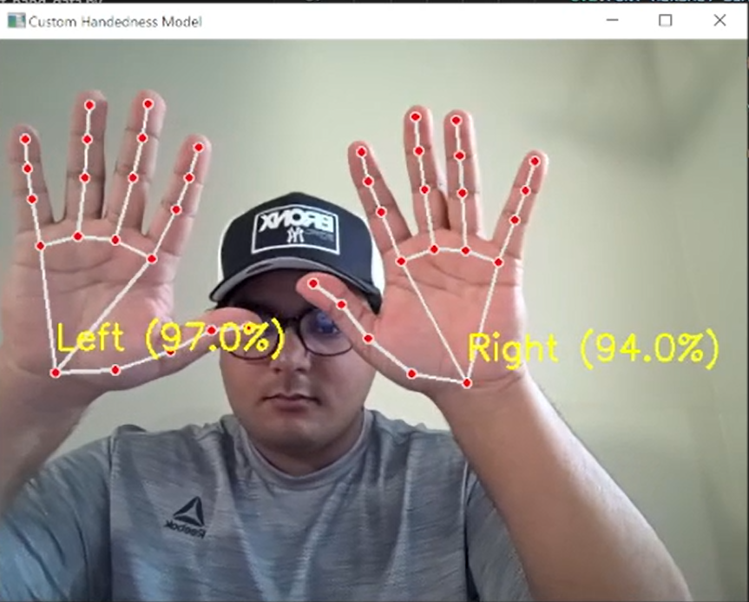
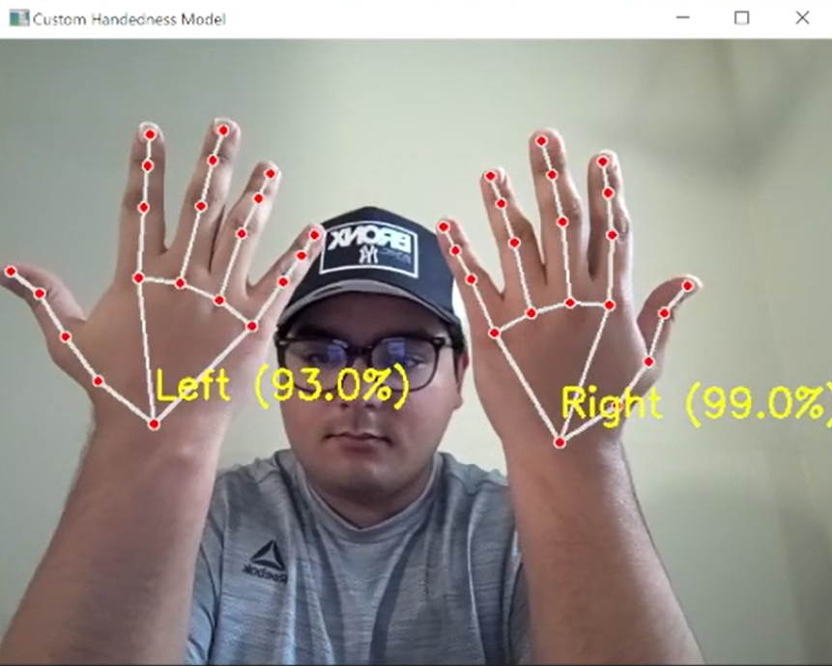
ML Model Integration
For the third and final python script, we integrated the custom-trained machine learning model from the previous .pkl file.
By using our own data set instead of MediaPipe’s built-in classification, the user is able to receive live predictions on whether a detected hand is left or right.
*Percentages displayed are the confidence score from the Random Forest Classifier

Slide 8
Thank You!

